Slide 1
NASA KSC Outreach Education Programs

Slide 2
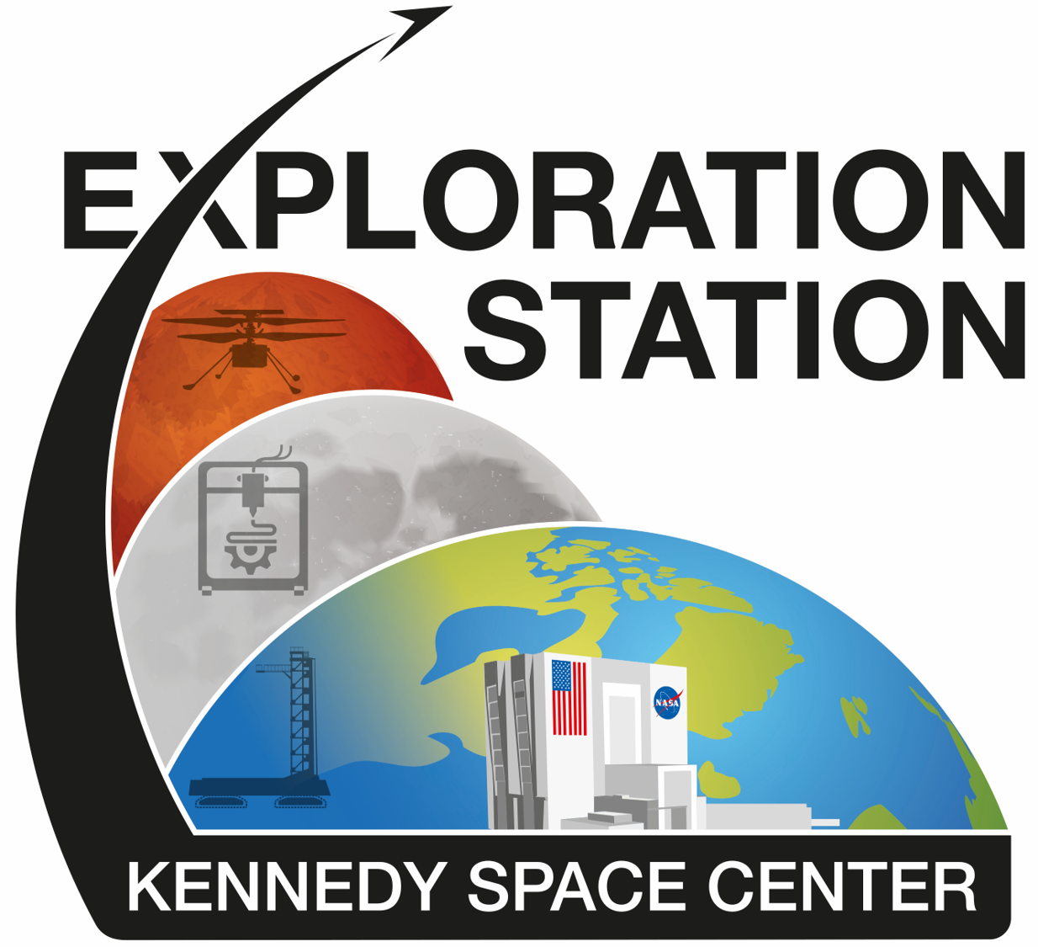
KSC Exploration Station
Operated by NASA and The Astronauts Memorial Foundation
Activity sessions focused on introducing students to NASA missions and associated STEM content
Sessions are 60 minutes and may be paired with morning or afternoon exploration of the Kennedy Space Center Visitor Complex
Exploration Station Booking Website: https://www.amfcse.org/es-scheduling-portal
Notes:
go over the process, the requirements/expectations, and all participants get an LTD for the day.
View schedule and sign group up online, will receive communication from team and educator will tailor lesson to grade level.
Minimum of 15 students, max 40. If more than 40 will need to book multiple sessions.
Topics include areas: Earth Science, engineering design, solar system exploration, working and living in space
Limited access tickets for all students and one chaperone per 10 students.
Limited number of sessions. Next opening of the calendar will be in November 2023 for the Spring time

Slide 3
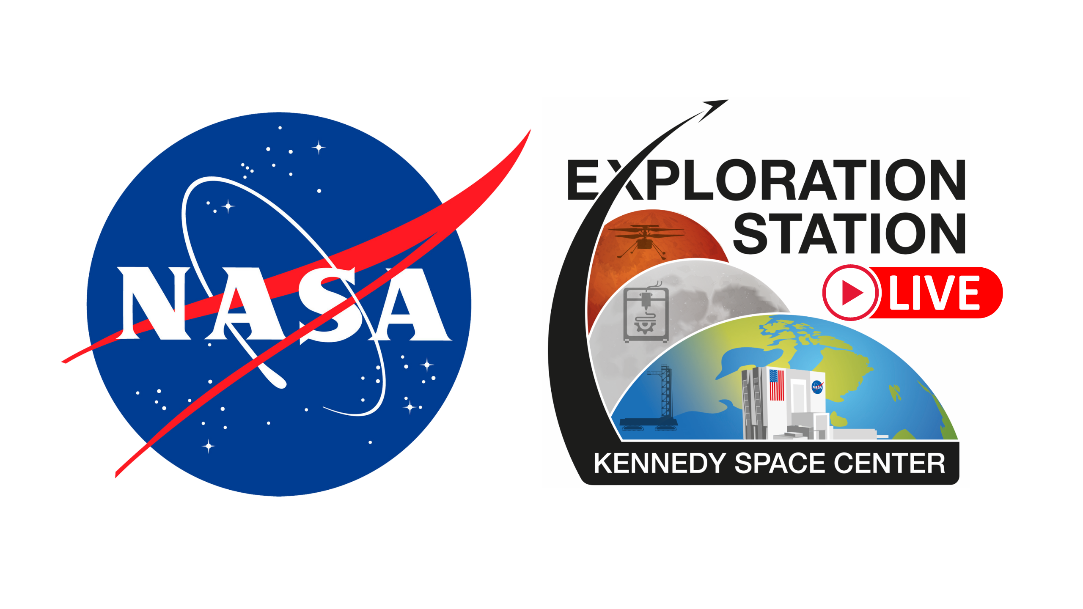
Exploration Station Live!
Stream a live presentation focusing on educating students about NASA missions, launches and important events.
Notes:
This is an extension of the classroom but more focus on the NASA specific launches. It will be a short summary of the mission covering things like Science payload, importance of the mission, crew bios if applicable. Access to the live recorded sessions can be found on the AMF ES website under the Virtual Connection Videos and Schedule.

Slide 4
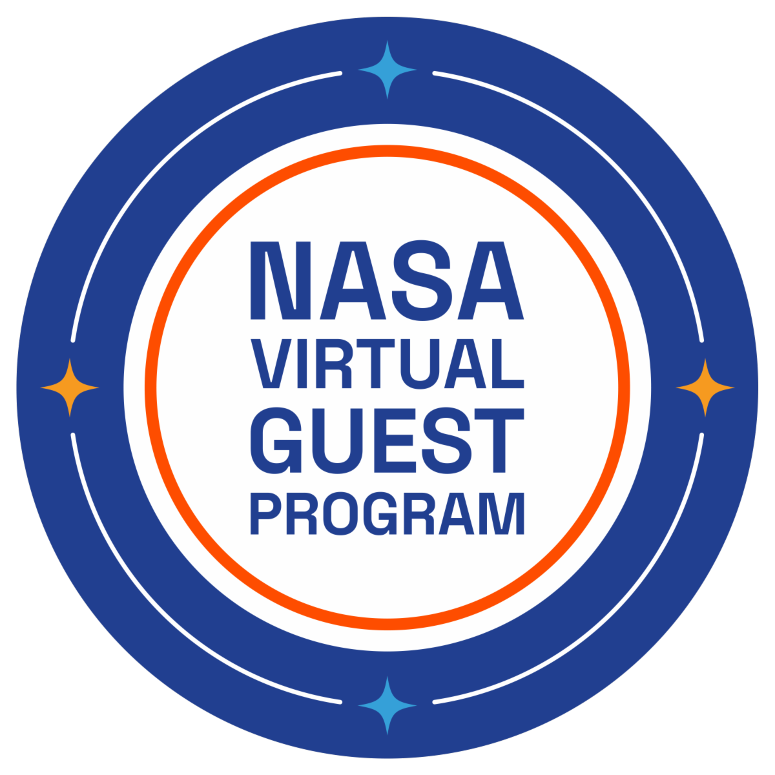
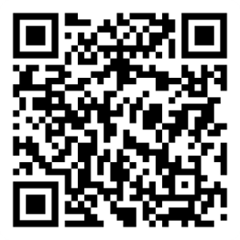
NASA Virtual Guest Program
Be a NASA virtual guest at launches and milestone events
Receive curated resources and mission specific information
Download your digital passport to document each launch
Following each launch viewed through the virtual guest program, receive a mission specific stamp for your passport!
Virtual Guest Program Video: https://www.youtube.com/watch?v=x_PTXnkDG_Y

Slide 6
Questions
Contact the KSC Exploration Station
Lester Morales, NASA KSC Exploration Station Manager
Kaylee Whalen, Exploration Station Education Specialist
Email: ksc-exploration-station@mail.nasa.gov

